Slide 1
Experience with Processes and Monitors in Mesa
Yen-Hsing Li
Philip Martin

Slide 2
Introduction
Motivation
Heavy users of concurrency used in Pilot OS(written in Mesa language).
Develop a model for controlling concurrency using monitor for:
Local concurrent programming
Global resource sharing
Replace use of interrupts

Slide 3
Problems
Program structure: How should programs be designed when monitors are used?
Creating processes: Previous work assumed a fixed amount of concurrency
Creating monitors: Fixed number of monitors is unacceptable
The consequence of wait call in a nested monitor call is not clear
Exceptions: How should the system handle exceptions when monitors are used?
Scheduling: How should monitors interact with process scheduling?
Input-output: Previous framework of monitors and condition variables didn’t work out.

Slide 4
Other Opportunities
They also consider other possibilities rather than monitor
Message passing
Will need more work compared to use a monitor scheme
Shared memory
It would not work on multiple processors
A separate mutex mechanism is needed
The restrictions for the use of non-preemption as mutex

Slide 5
Processes in Mesa
Process creation in Mesa: Any procedure call can be prefixed by ‘fork’
For example, ReadLine(terminal) -> fork ReadLine(terminal)
Processes in Mesa are treated exactly like any other value: they can be passed as arguments, assigned to variables, etc.

Slide 6
Monitors
The data is protected by the monitor, two methods to access the data:
Entry procedures: Processes can only perform operation for data from calling it.
Internal procedures : Can only call from monitor procedures.
Only one process can be inside monitor and access the shared data.
If a random order of calling entry procedures is not acceptable, other provisions must be made in the program outside the monitor.

Slide 7
Monitor module
Monitor modules:
Three kinds of procedure: entry(public), internal (private), and external (non-monitor procedures)
Shared data should be accessed through entry procedures
Condition variable: wait, notify
If the monitor calls some other procedure which is outside the monitor module, the lock is not released.

Slide 8
Monitor and Deadlock
There are three patterns of pairwise deadlock that can occur using monitors
Two processes do a WAIT
cyclic calling pattern between two monitors.(M calls N, each will wait)
if M calls N, and N then waits for a condition which can only occur when another process enters N through M and makes the condition true.
Monitor is a tool for synchronization and it is the programmer's responsibility to be careful not to cause deadlock.

Slide 9
Abandoning a Computation
If Call chain: P1 -> P2 -> ... -> Pm -> Pn
Pi is an entry (monitor) function
P1 handles exception generated by Pn
P1 should abandon the portion computation done in P2 ... Pn
How to release the monitor lock for Pi?
=> call UNWIND method

Slide 10
Condition Variables in Mesa
Condition Variables act as “hints” to wake up threads that may be able to run
Wakeup can happen at any time
Must then check if condition actually holds
Only invariants can be assumed
Flexibility allows use of “cheap” notification conditions

Slide 11
Other Wakeup Cases
Timeout – threads may wake up after a fixed interval
Abort – another process can signal to abort next time this one waits
Broadcast – wakes up all waiting threads at once

Slide 12
Naked Notify
I/O devices wake up processes by notifying a condition variable
Atomic write to a fixed location to notify
Race condition as notify isn’t protected by monitor lock
Use wakeup-waiting switch
Don’t want slow devices acquiring monitor locks on code

Slide 13
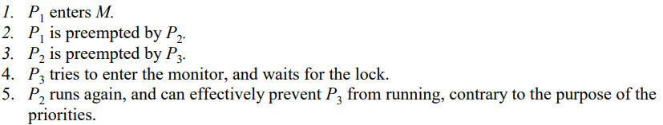
Priority Inversion
In priority schedulers, a high-priority process waiting on a low-priority process can be starved unjustly
Consider this sequence with P3 being highest priority:
Avoid by donating priority of highest-priority thread in that monitor

Slide 14
Implementation: Processes
A process is represented by its stack and state
A state is always on one of four queues:
Ready
Monitor lock
Condition variable
Fault
Each queue is kept sorted by priority

Slide 15
Implementation: Life Cycle
Creation and destruction of processes uses monitor semantics
Unused process slots wait to be born
Fork sets up a process and then notifies it to wake up
End causes a process to wait to be born again
Abort and Yield allow handling of excessive waiting or computing

Slide 16
Implementation: Performance
Monitors provide convenient interfaces, but incur overhead
Time and space used is typically small compared to most procedures
Call + Return from monitor ~1.7x regular function call
Process switch ~2x function call
Wait ~.5 function call
Notify ~.2 function call
Fork/Join ~38x function call
Could be faster if done in hardware

Slide 17
Applications: Pilot
OS for a personal computer
~40 monitors and 15 dedicated processes
I/O with naked notifies
Fault queues
Internal exceptions wake up handler processes
Issues:
Various deadlocks
Signals (like unwind) must be handled by monitors

Slide 18
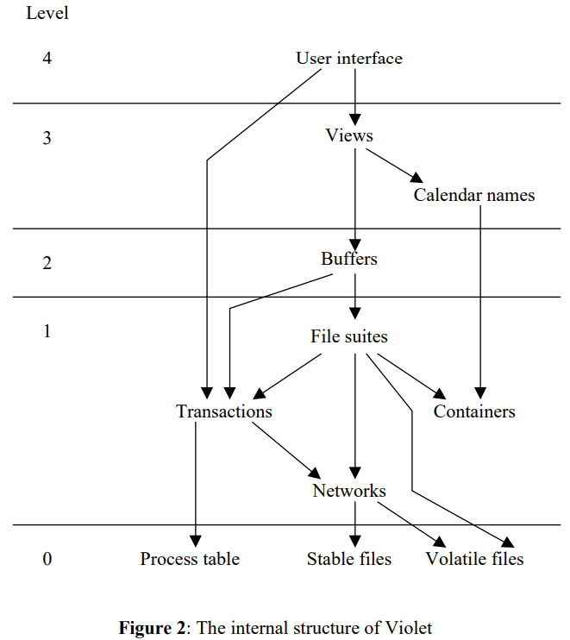
Applications: Violet
Distributed database manager/calendar system
Abstraction hierarchy of processes
Higher levels call lower levels
Monitor notifications used to alert processes when data updates

Slide 19
Applications: Gateway
Passes packets between two or more networks
Processes for device drivers, sockets, dispatcher
May be very many in total
Monitors synchronize interactions to send/receive packets

Slide 20
Conclusion
Robust monitor implementations are complex due to a variety of uses and edge cases
Mesa monitors have succeeded in a variety of applications
Some bugs found, but generally not hard to fix

